Slide 1
Recap: Ways of specifying gas concentration
Percent (%) can be thought of as parts per hundred.
Atmospheric O₂ concentration is 21%. If you grab a hundred air molecules, 21 will be O₂
Atmospheric N₂ concentration is 78%. If you grab a hundred air molecules, 78 will be N₂
Parts per million (ppm) is useful when the concentration is smaller than 1%.
Atmospheric CO₂ concentration is 419 ppm (as of January, 2022) … if you grab a million air molecules, 419 of them will be CO₂
Parts per billion (ppb) is useful when the concentration is even smaller.
N₂O concentration in preindustrial times was 270 … if you grabbed a billion air molecules, 270 of them would have been N₂O
Notes:
Concentrations of CO₂, CH₄, N₂O, and other anthropogenic greenhouse gases are on the rise, so you’ll find that values in the literature vary.
Concentrations of other pollutant gases vary a lot with location
ppm and ppb are sometimes written ppmv and ppbv

Slide 2
Recap: Gas concentrations in earth.nullschool.net
Went to earth.nullschool.net to see if you can find locations that have especially high or low CO₂ concentrations – results?

Slide 3
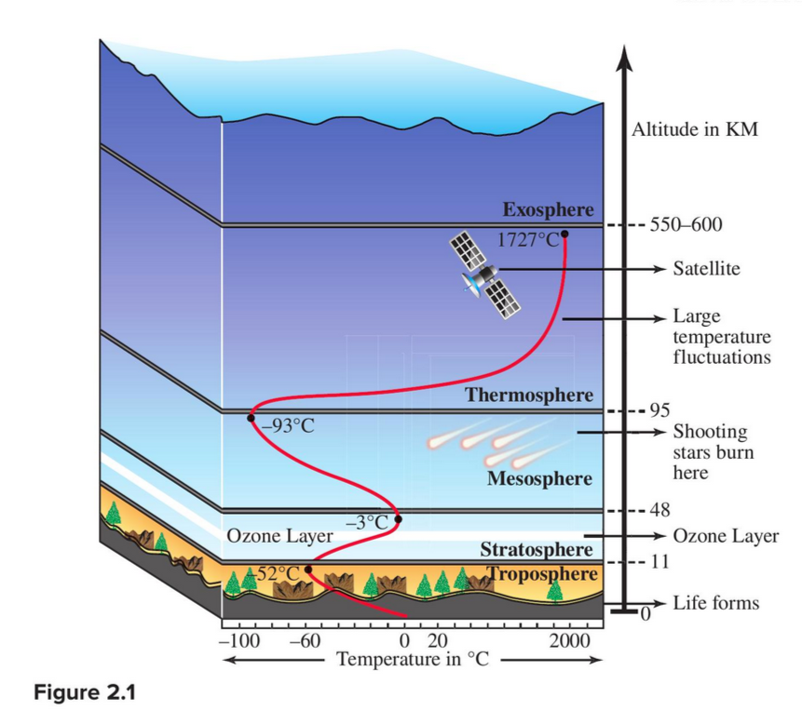
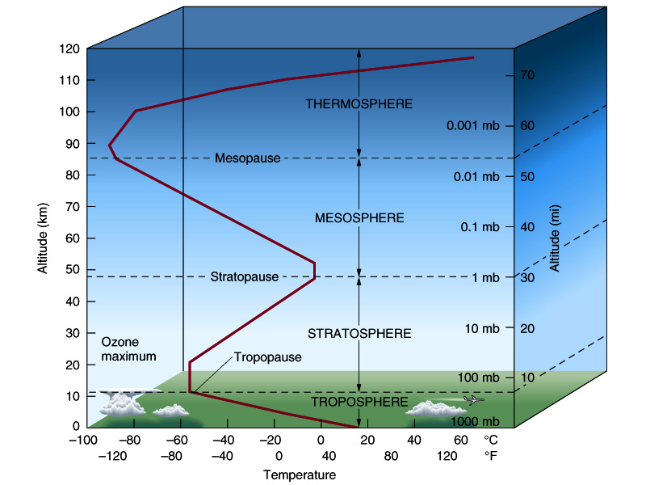
Recap: Temperature structure of the atmosphere
This figure goes up to 120 km
Figure 2.1 from the text – up past 600 km
Tropospheric composition: 78% N₂, 21% O₂, 1% Ar and other trace gases

Slide 4
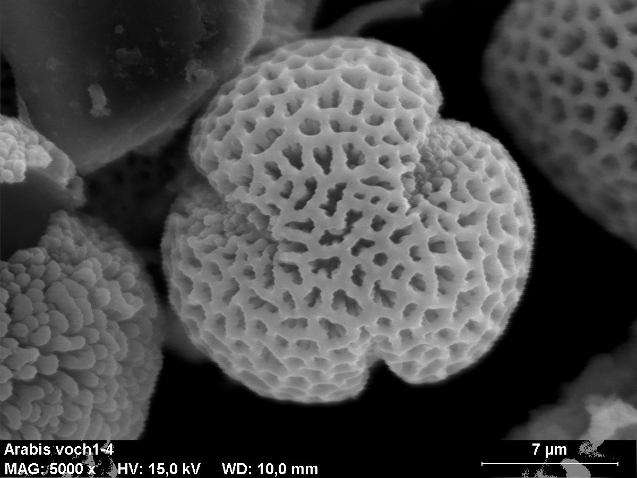
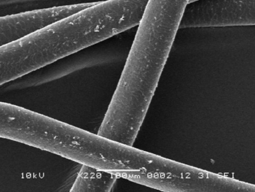

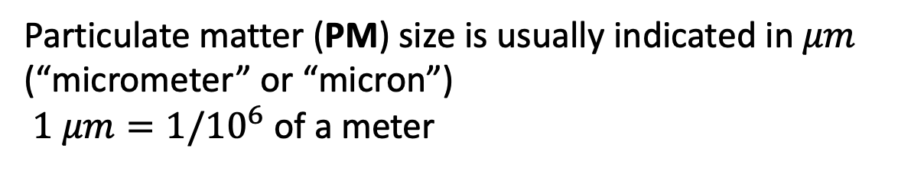



Particulate matter (also called aerosols) are also pollutants
Particulate matter (PM) size is usually indicated in $μm$ (“micrometer” or “micron”)
$1 μm=1/{10}^{6}$ of a meter
Wildfire smoke, other sources of black carbon:
0.01 to 10 $μm$
Pollen:
~10 $μm$
(same as cloud droplets)
Human hair width
100 $μm$
Mineral dust:
0.01 to 10 $μm$

Slide 5
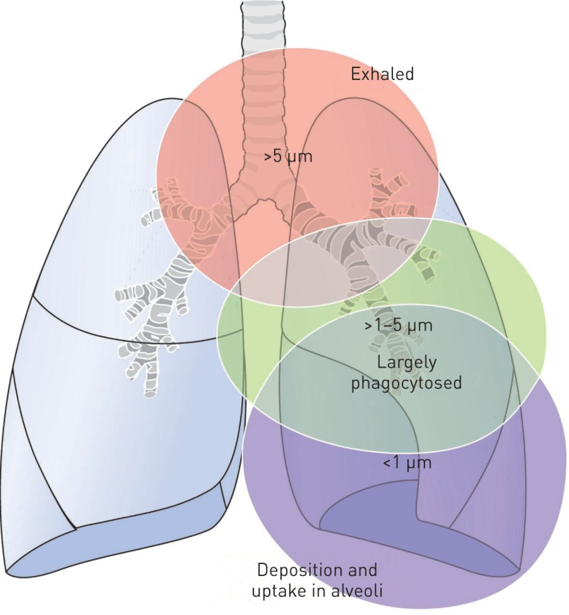
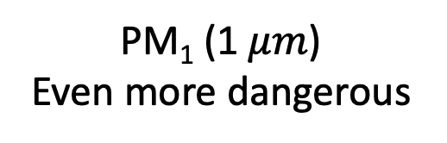
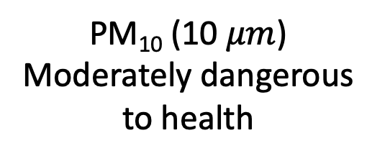
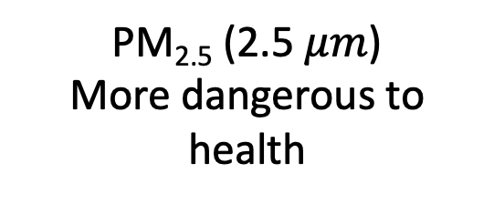
Aerosol size is important because of relevance to human health
PM₁₀ (10 $μm$)
Moderately dangerous to health
PM_{2.5} (2.5 $μm$)
More dangerous to health
PM₁ (1 $μm$)
Even more dangerous
https://erj.ersjournals.com/content/erj/44/3/765/F1.large.jpg?download=true

Slide 6
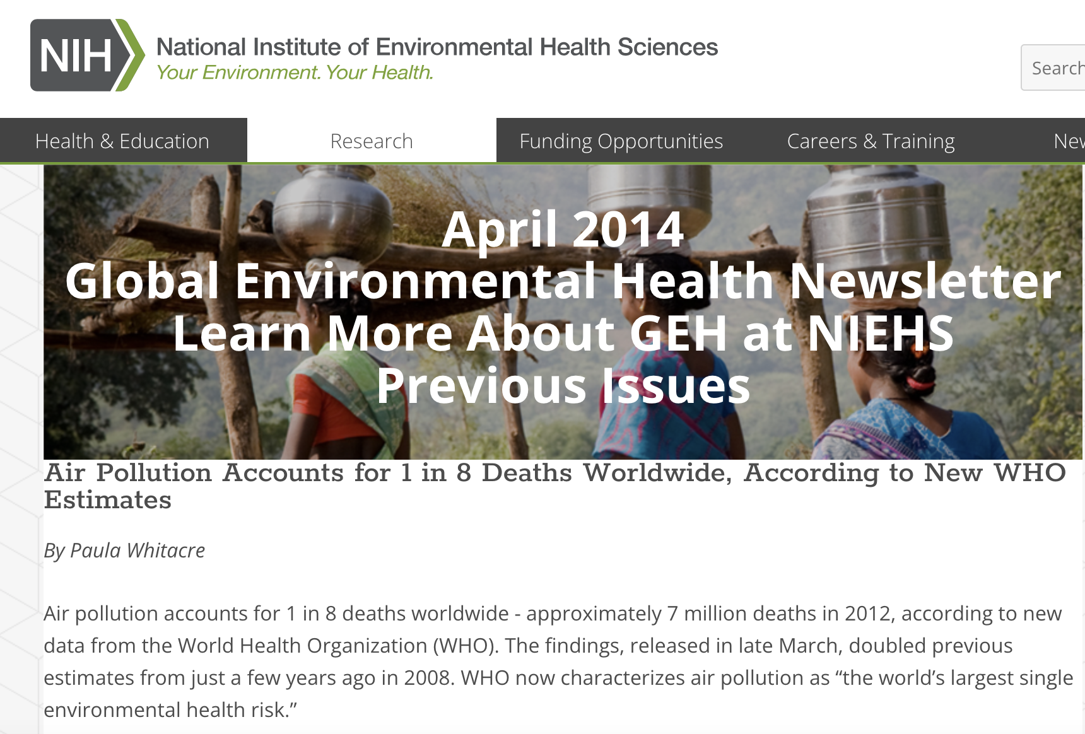
Aerosol size is important because of relevance to human health
https://www.niehs.nih.gov/research/programs/geh/geh_newsletter/2014/4/articles/air_pollution_accounts_for_1_in_8_deaths_worldwide_according_to_new_who_estimates.cfm

Slide 7


Aerosol composition is important because of relevance to climate
Wildfire smoke, other sources of black carbon:
0.01 to 10 $μm$
Mineral dust:
0.01 to 10 $μm$
Wildfire smoke (and soot from coal combustion) tends to seed more clouds (called a “cloud adjustment”), which cools the earth, but if it lands on snow, it makes the snow absorb more sunlight, which warms the earth.
Dust tends to reflect sunlight, so it cools the earth. The reflectivity of Earth is also called its albedo.
Mt. Pinatubo eruption in 2001 cooled Earth by 1 degree F for two years!

Slide 8
Aerosol composition is important because of relevance to climate
Wildfire smoke, other sources of black carbon:
0.01 to 10 $μm$
Mineral dust:
0.01 to 10 $μm$
Wildfire smoke (and soot from coal combustion) tends to seed more clouds (called a “cloud adjustment”), which cools the earth, but if it lands on snow, it makes the snow absorb more sunlight, which warms the earth.
Dust tends to reflect sunlight, so it cools the earth. The reflectivity of Earth is also called its albedo.
Mt. Pinatubo eruption in 2001 cooled Earth by 1 degree F for two years!
Future impacts of aerosols on climate are a big unknown

Slide 9
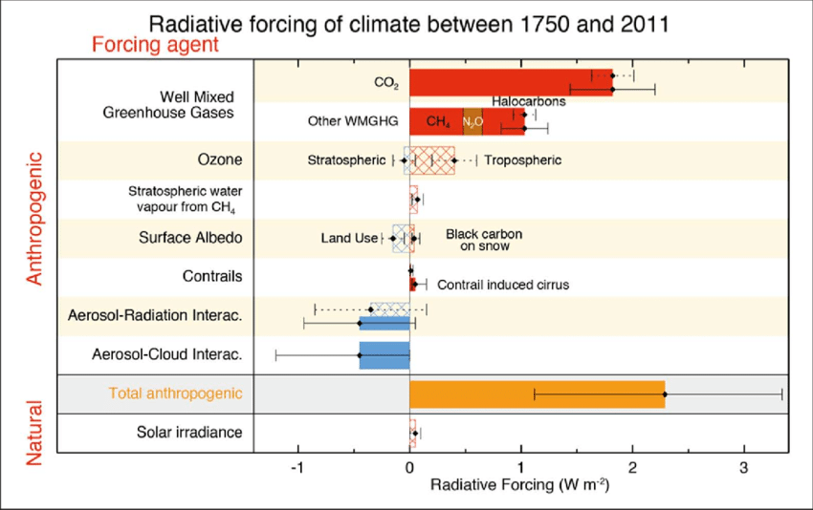
IPCC and radiative forcing
https://www.researchgate.net/profile/Franz_Mauelshagen/publication/263470663/figure/download/fig5/AS:654076018700289@1532955283491/Radiative-forcing-of-climate-bar-chart-showing-totals-for-1750-2011-RF-hatched-and.png

Slide 10
Aerosol concentrations in earth.nullschool.net
Go to earth.nullschool.net and see if you can find locations that have especially high or low particulate matter concentrations.
Also check out fires.

